Slide 1
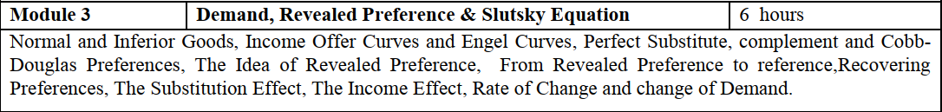

Slide 2
Normal and Inferior good
Income offer curve

Slide 3

Engel curve
$x_{i}=x_{1}\left(p_{i},p_{2},m\right)$: Guess what?
Then
$x_{i}=x_{1}\left(p_{1},p_{2},m_{i}\right)$: what is this?

Slide 4







$x_{1}$
$$m_{3}$$
$$m_{2}$$
$$m_{1}$$
$$x_{1}$$
$$x_{1}^{i}$$
$$x_{1}^{ii}$$

Slide 5
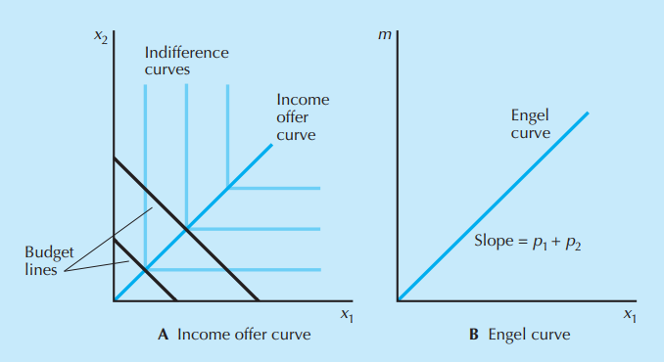
Example: perfect complement

Slide 6

Since the consumer will always consume the same amount of each good, no matter what, the income offer curve is the diagonal line through the origin.
Since the demand for good 1 is→ $x_{1}=\frac{m}{p_{1}+p_{2}}$

Slide 7
Ordinary good and Giffen good
Let’s now consider price changes
Suppose that we decrease the price of good 1 and hold the price of good 2 and money income fixed. Then what can happen to the quantity demanded of good 1
This is ordinary good
Decrease/increase in the price of certain good leads to reduction/increase in the quantity demanded of that good
Such goods are called Giffen good

Slide 8
Why giffen?
Consider a family with maximum expenditure on food 400 rupees
Minimum consumption required 50 kg ( rice and wheat)
Good | Price | Qty | Expenditure
Rice | 5 | 40 | 200
Wheat | 20 | 10 | 200
Good | Price | Qty | Expenditure
Rice | 6 | 40 | 240
Wheat | 20 | 10 | 200

Slide 9
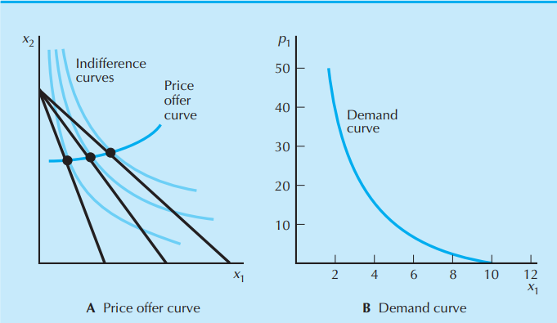
The relationship between Price offer curve and demand curve
P=50
P=30
P=20
2
3
4

Slide 10
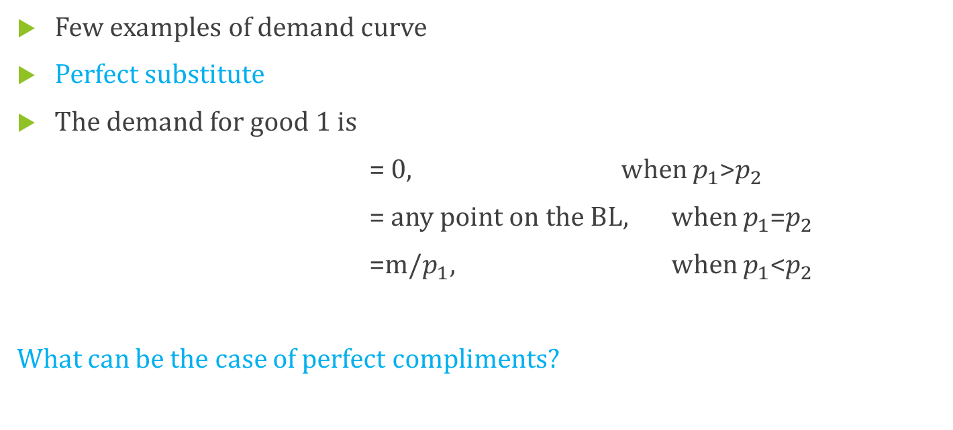
Examples
Few examples of demand curve
Perfect substitute
The demand for good 1 is
= 0, when $p_{1}$>$p_{2}$
= any point on the BL, when $p_{1}$=$p_{2}$
=m/$p_{1},$ when $p_{1}$<$p_{2}$
What can be the case of perfect compliments?

